Slide 1
The Big Announcement
You Can Influence How Your Audience Receives It
Olivia Hudson
Solution Seekers, Inc.

Slide 2
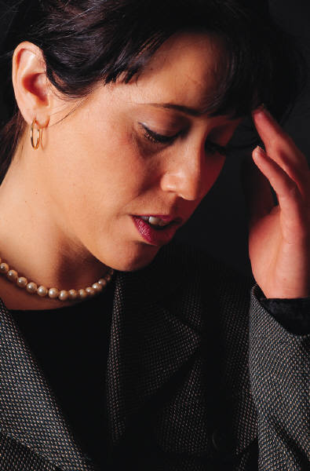
“Change”
Good
Bad
Fear
Dread
Resistance
Notes:
Change can be both good and bad
Many people find change difficult
Even when change is good, people can:
Feel fear
Feel dread because they know an adjustment is necessary
Be resistant

Slide 3

Control the Rumors
Don’t create false expectations
Do explain things in a positive way
Notes:
Don’t
Pre hype your message
Claim to be “awesome”
Audience expectations can be so high that you can’t measure up to them
Do
Build excitement for the news
Build enthusiasm
Give your audience more than they expect

Slide 4

Your Delivery
Don’t be insincere or “slick”
Do be confident and caring
Notes:
Don’t
Be slick
Be insincere or sarcastic
Use silly examples in an effort to be humorous
Be stiff
Do
Appear relaxed
Be confident
Use humor skillfully to make a point
Project a caring attitude

Slide 5

Know Your Audience
Don’t be condescending
Do show your understanding
Notes:
Don’t
Use terminology the audience does not have the background to understand
Act superior
Show a condescending attitude
Do
Show that you understand your audience’s background
Relate your examples to their experiences
Show your understanding of their needs and wants

Slide 6

The Bottom Line . . .
Treat people as you would like to be treated
Notes:
Be sincere
Treat people as you would like to be treated

